Slide 1
Introduction To Computers
Md.al-amin
Lecturer,Cs, AIUB
Email: alamin@aiub.edu

Slide 2
Learning Objectives
Computer
Data processing
Characteristic features of computers
Computers’ evolution to their present form
Computer generations
Characteristic features of each computer generation

Slide 3
Computer
The word computer comes from the word “compute”, which means, “to calculate”
Thereby, a computer is an electronic device that can perform arithmetic operations at high speed
A computer is also called a data processor because it can store, process, and retrieve data whenever desired

Slide 4
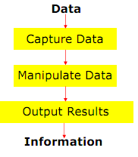
Data Processing
The activity of processing data using a computer is called data processing
Data is raw material used as input and information is processed data obtained as output of data processing

Slide 5
Characteristics of Computers
Automatic: Given a job, computer can work on it automatically without human interventions
Speed: Computer can perform data processing jobs very fast, usually measured in microseconds (10-6), nanoseconds (10-9), and picoseconds (10-12)
Accuracy: Accuracy of a computer is consistently high and the degree of its accuracy depends upon its design.
Diligence: Computer is free from monotony, tiredness, and lack of concentration. It can continuously work for hours without creating any error and without grumbling

Slide 6
Characteristics of Computers
Versatility: Computer is capable of performing almost any task, if the task can be reduced to a finite series of logical steps
Power of Remembering: Computer can store and recall any amount of information because of its secondary storage capability. It forgets or looses certain information only when it is asked to do so
No I.Q.: A computer does only what it is programmed
to do. It cannot take its own decision in this regard
No Feelings: Computers are devoid of emotions. Their
judgement is based on the instructions given to them in
the form of programs that are written by us (human
beings)

Slide 7
Evolution of Computers
Blaise Pascal invented the first mechanical adding machine in 1642
Baron Gottfried Wilhelm von Leibniz invented the first calculator for multiplication in 1671
Keyboard machines originated in the United States around 1880
Around 1880, Herman Hollerith came up with the concept of punched cards that were extensively used as input media until late 1970s

Slide 8
Evolution of Computers
Charles Babbage is considered to be the father of modern digital computers
He designed “Difference Engine” in 1822
He designed a fully automatic analytical engine in 1842 for performing basic arithmetic functions
His efforts established a number of principles that are fundamental to the design of any digital computer

Slide 9
Some Well Known Early Computers
The Mark I Computer (1937-44)
The Atanasoff-Berry Computer (1939-42)
The ENIAC (1943-46)
The EDVAC (1946-52)
The EDSAC (1947-49)
Manchester Mark I (1948)
The UNIVAC I (1951)

Slide 10
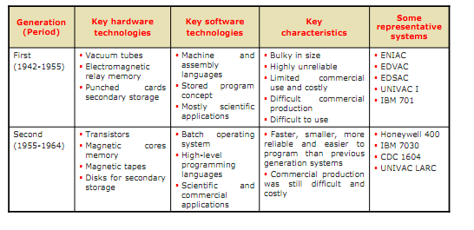
Computer Generations

Slide 11
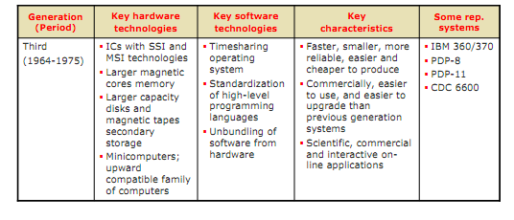
Computer Generations

Slide 12
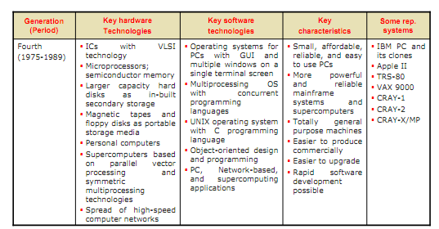
Computer Generations

Slide 13
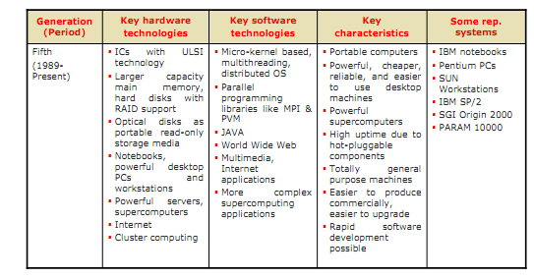
Computer Generations

Slide 14

THANK YOU

